Slide 1
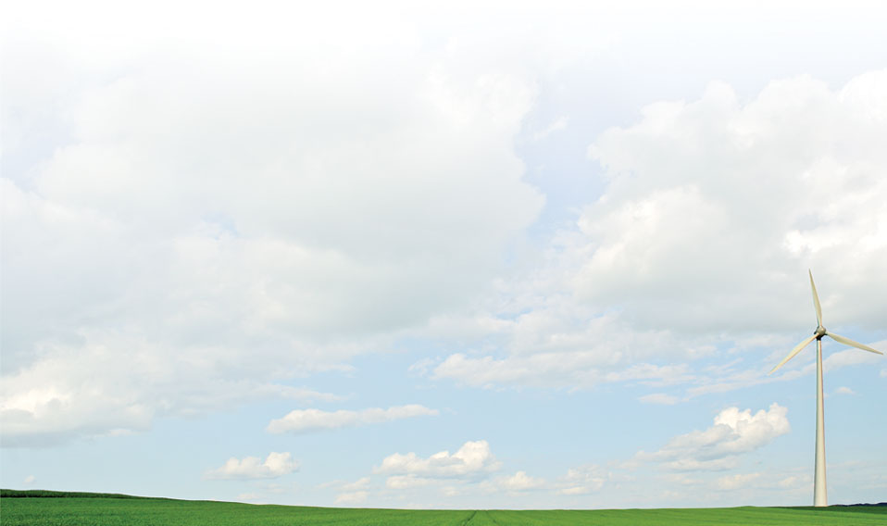
Recorders
This section will introduce you to objects that record data in other objects.

Slide 2
Output object
Implemented in tape module
One of two primary ways of collecting data
Recorders observe one or more properties of a single object
Several possible destinations for data
  File : source is a specially formatted files
  ODBC : source is a database
  Memory : source is a global variable
  Plot : gnuplot output

Slide 3
Property
Name of parent’s property that is recorded
Internal data conversion is performed
  Conversion is to text output
  Booleans uses TRUE or FALSE and/or 0 or 1
  Integers use decimal integer
  Enumerations and set use keywords
  Doubles use double_format
  Complex uses complex_format
  Object references use object_format
No unit conversion is performed

Slide 4
File
Meaning differs based on filetype property
Format can be system specific
  “/” are normally used; “\” allowed in Windows
File must be writeable
Path to file is not automatically created
Existing file are overwritten
Write failure is warned, but ignored

Slide 5
Interval
Determine the sampling interval for data
Units are seconds
-1 means sample transients (on change)
0 means sample each iteration

Slide 6
Limit
The maximum number of samples
Limits the size of the output file
0 is default
0 means no limit

Slide 7
Trigger
Specifies condition to start recording
Works only for target property
Usual compare ops apply
Examples
  “< 0” : starts recording when property is negative
Once triggered, recording continues to limit

Slide 8
Demo
//demo of player_recorder.glm
module residential;
module tape;
clock {
timezone PST+8PDT;
timestamp '2001-01-01 0:00:00';
}
module residential;
module tape;
object house:1 {
heating_setpoint 40degF;
cooling_setpoint 90degF;
}
object player {
parent house:1;
property cooling_setpoint;
file theat.csv;
loop 100; //loop for 100 days but does not move the time stamp
}
object recorder{
parent house:1;
property air_temperature,cooling_setpoint;
file theat_record.csv;
interval 7200; //records every 2 hours
limit 48;
}

Slide 9
Demo
Demo of player_recorder_interval.glm
    module residential;
    module tape;
    clock {
    timezone PST+8PDT;
    timestamp '2001-01-01 0:00:00';
    }
    module residential;
    module tape;
    object house:1 {
    heating_setpoint 40degF;
    cooling_setpoint 90degF;
    }
    object player {
    parent house:1;
    property cooling_setpoint;
    file theat.csv;
    loop 100; //loop for 100 days but does not move the time stamp
    }
    object recorder{
    parent house:1;
    property air_temperature,cooling_setpoint;
    file theat_record_0.csv;
    interval 0; //every iteration - 9pm and 6am
    limit 48;
    }

Slide 10
Example
Interval -1, 0, 7200
Demo of player_recorder_trio.glm
  object player {
  parent house:1;
  property cooling_setpoint;
  file theat.csv;
  loop 100; //loop for 100 days but does not move the time stamp
  }
  object recorder{
  parent house:1;
  property air_temperature,cooling_setpoint;
  file theat_record.csv;
  interval 7200; // records 2hours
  limit 48;
  }
  object recorder{
  parent house:1;
  property cooling_setpoint;
  file theat_record1.csv;
  interval 0; // every iteration in this case 9pm and 6am
  limit 48;
  }
  object recorder{
  parent house:1;
  property air_temperature,cooling_setpoint;
  file theat_record2.csv;
  interval -1; //writes every time any object changes in state and when the time stamp moves forward
  limit 48;
  }

Slide 11
Exercises
Create a recorder to collect hourly indoor air temperature of the default house for the year 2001.
Create a recorder to collect 100 values of the default waterheater power transitions in the default house.
Create a recorder to collect the voltage of the feeder (node:781) in the IEEE 37 node test model as it converges.

